Slide 1

Resume Screening USING VECTOR SPACE MODEL
An Information retrieval project by
Chaitanya Addepalli
Srijanya Chetikaneni
Sree Lasya Thatigutla

Slide 2
Agenda
Introduction
Architecture
Methodology
Demo
Results
Future Work

Slide 3

Why do WE need resume screening?

Slide 4
Introduction
Resume screening is an important and time-consuming aspect of the decision-making process in any recruitment.
Crucial yet challenging part of the hiring process.
Automated Model :
Saves Time
More Efficient and Accurate

Slide 5
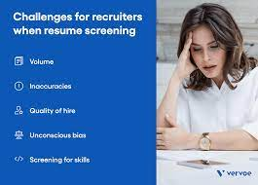
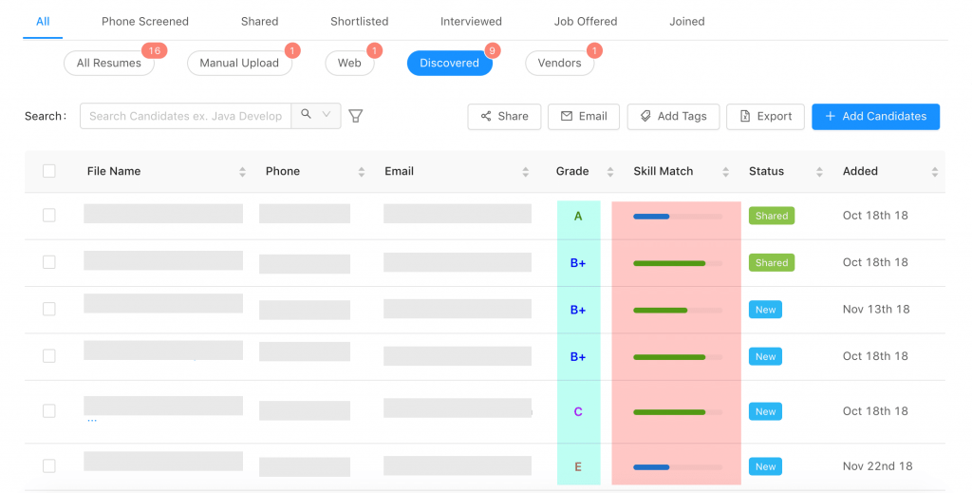
Manual Resume Screening
Automated resume screening
User Driven
Time-consuming and Labor intensive
System Driven
Saves time and reduces the required man hours

Slide 6
Query
Data Loading
Preprocessing
User Interface
Tokenization
Indexing
Doc vector
Preprocessing
Indexing
Query Vector
Cosine similarity
Display Search Results to UI

Slide 7
Platforms
Python
Pycharm IDE
Python’s Tkinter library for UI

Slide 8
Methodology
Data Preprocessing
Indexing and Generating Doc Vectors
Cosine Similarity
Retrieve Ranked Resumes

Slide 9
Data Preprocessing
We used a dataset of 2484 resumes which are in pdf format.
This data has been preprocessed by removing punctuations and the documents are tokenized.
Stop Words (the, and, or etc.) are removed.
We have used Porter stemmer algorithm for stemming

Slide 10
Indexing:
We created an index for all the preprocessed unique terms from the dataset.
Index contains the term, document Id, and term frequency.
TF-IDF is used to create document vectors and query vector.
Cosine Similarity:
Calculated similarity between document vector and given query vector by using cosine similarity.
Retrieve the top resumes based on their similarity.

Slide 11
Retrieve Resumes
For the given keywords, our model retrieves the top 10 resumes with the highest cosine similarity.
Displays the resume ID and similarity in the UI.

Slide 12
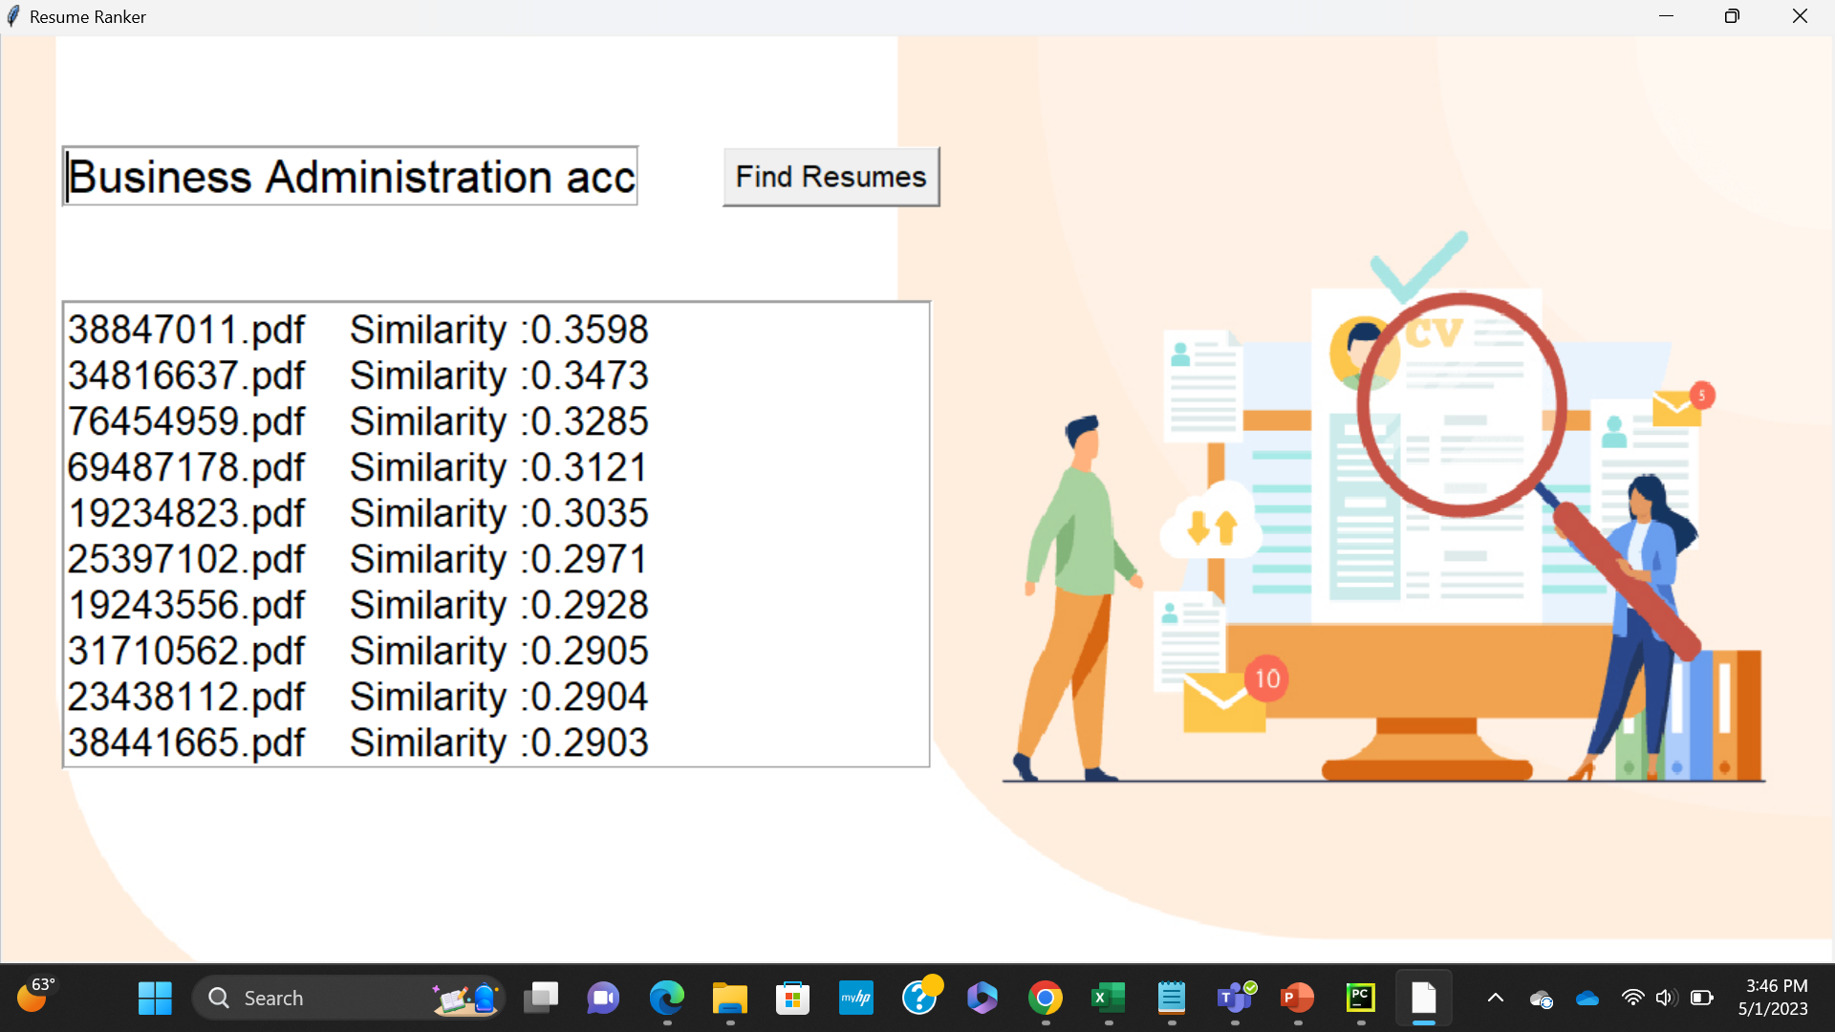
Results

Slide 13
Evaluation
To evaluate our model, we randomly picked a resume and passed it as a query.
Our model has retrieved the same resume as the top document with a similarity close to '1'
Other resumes similar to this profile have also been retrieved.
So, this model can also be used to retrieve resumes that are actually similar to an existing candidate’s profile.

Slide 14
Future Work
We will further optimize the existing model for faster retrieval of results
We are currently implementing the K means clustering to cluster the pool of resumes into different job categories
This can help segregate the dataset for better distribution of the resumes in the recruitment process

